Slide 1
Data Science Engineering Methods and Tools Midterm Project
Fifa 2018-19 Prediction Analysis
Problem Description:
Predicting the Value of the Player from 2019 Data set on the basis of the Performance history from 2018 data set
-By
You fu
Dhaval Pandya
Drishti Shishodiya
Supriya Murty

Slide 2
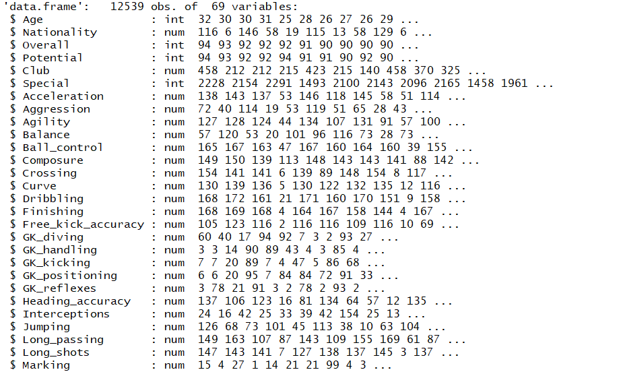
Initial understanding of the data set:
Year | Total Observations | Features
2018 | 17981 | 75
2019 | 18207 | 90
Player Played in 2018 and 2019 | Player Played in 2018 and not in 2019
12539 | 5442
Challenges:
There are multiple player with exact same name who are playing for different clubs, while we join data using Name column it gives duplicate results.
Since each player has unique Id associated with him , Merging the data through Id results in more efficient estimation of data analysis.
Removed correlated/Less important Features from 2018 Data Set
Such as Column 0,Photo,Flag,Club Logo
We are ignoring Value, Wage feature as per requirement

Slide 3
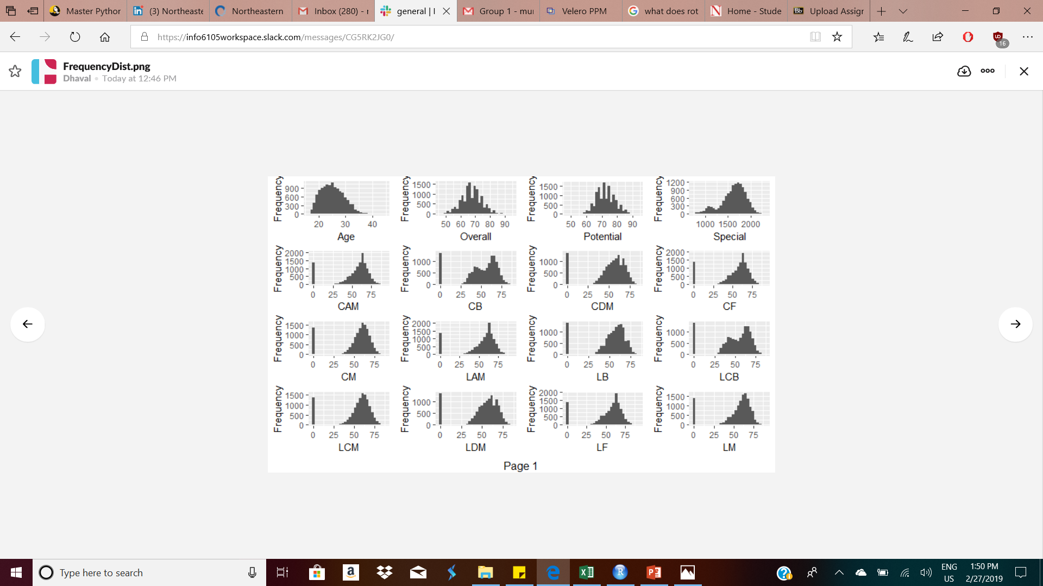
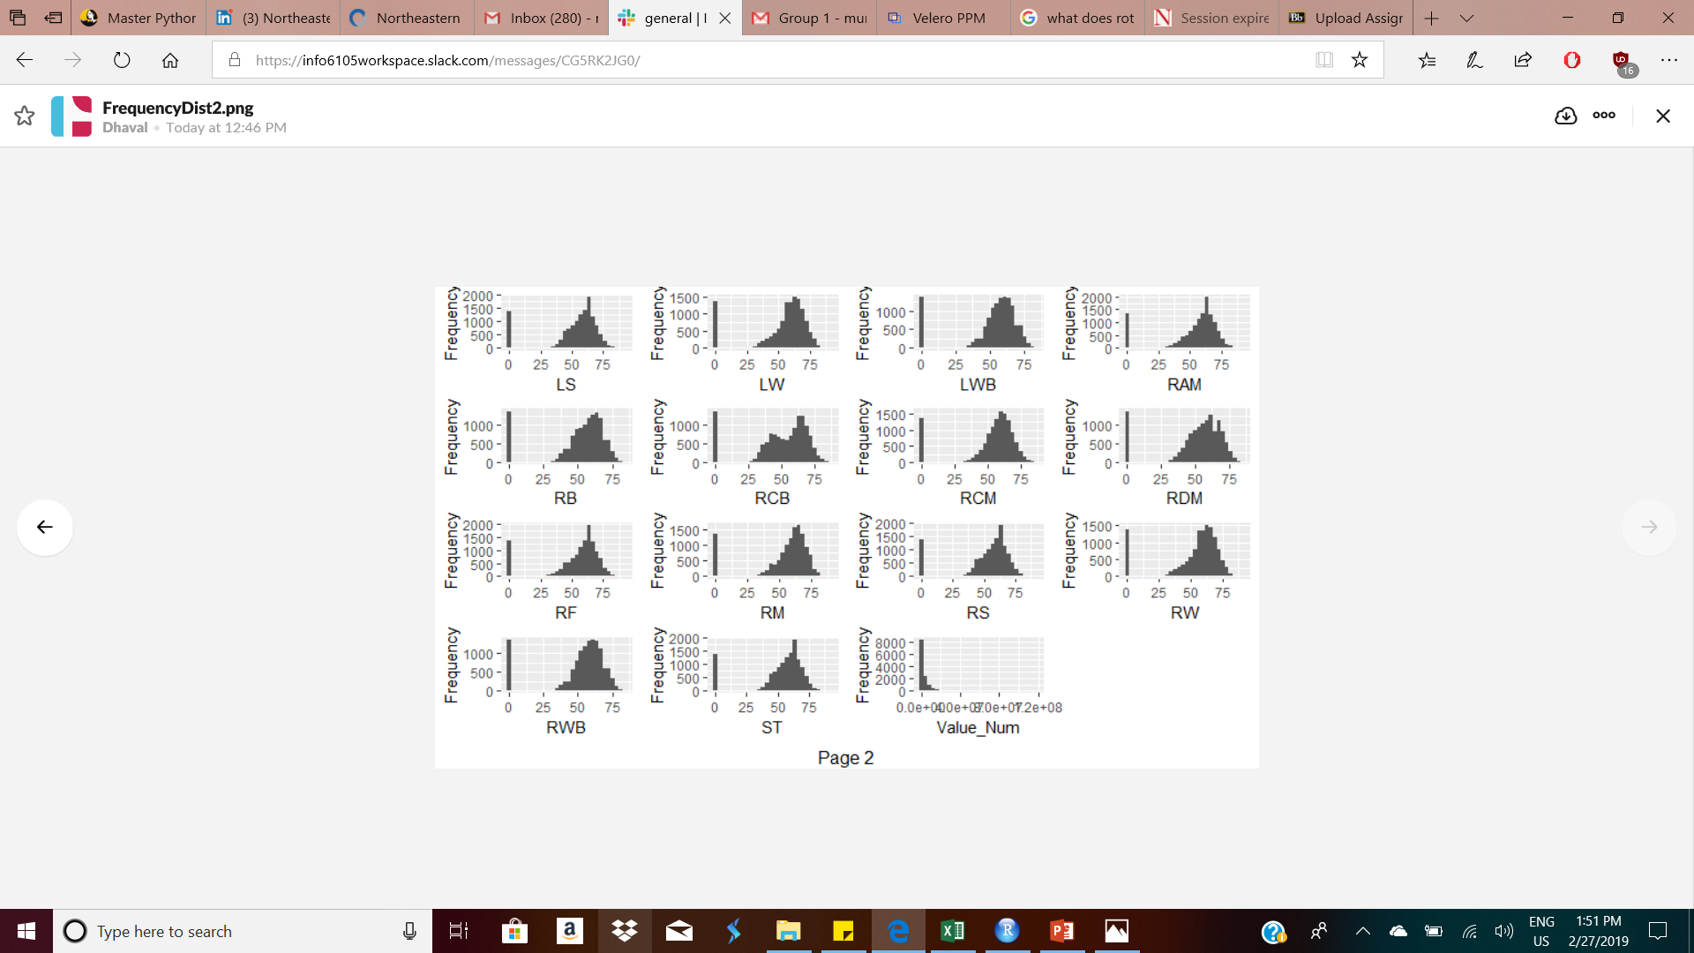
Data set Feature Distribution:
Feature 1
Feature 2

Slide 4
Data Cleaning
After merging the 2018-19 data set using the ID attribute, we found many missing value and inconsistent data.
We have decided to fill out missing value with 0, Min, Max and Average value of that particular feature.
There were many missing values and categorical variables. We factorize categorical value in R and convert to numeric value.
We also converted the dependent variable Value Feature into its exact numerical equivalent as we have like 2000K or 2M.
After Data Cleaning Process :
 | No. of Observation | No. of Feature
Total | 12416 | 69
Train (80 % of Total) | 10031 | 69
Test (20 % of Total) | 2508 | 69

Slide 5
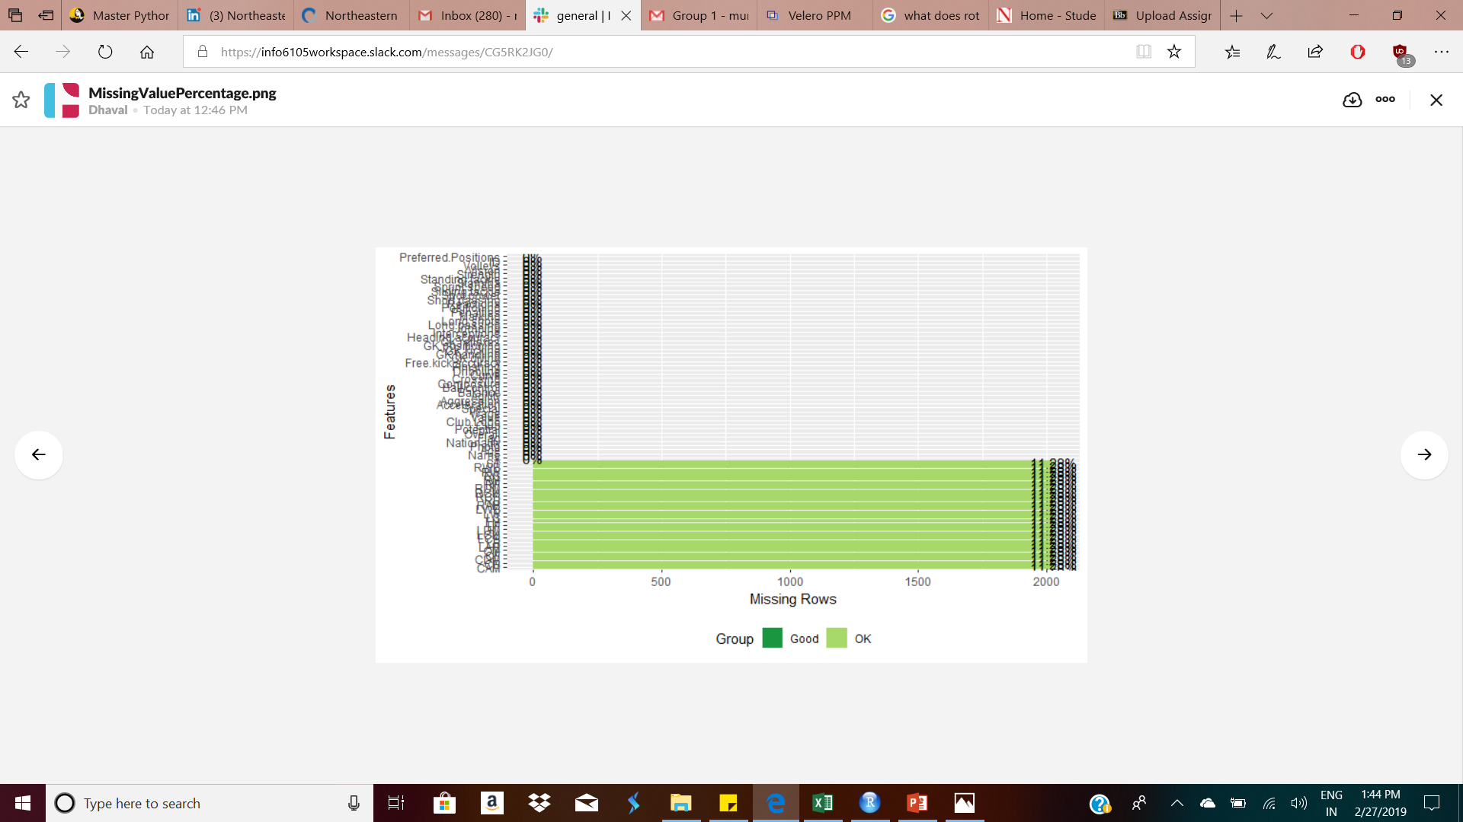
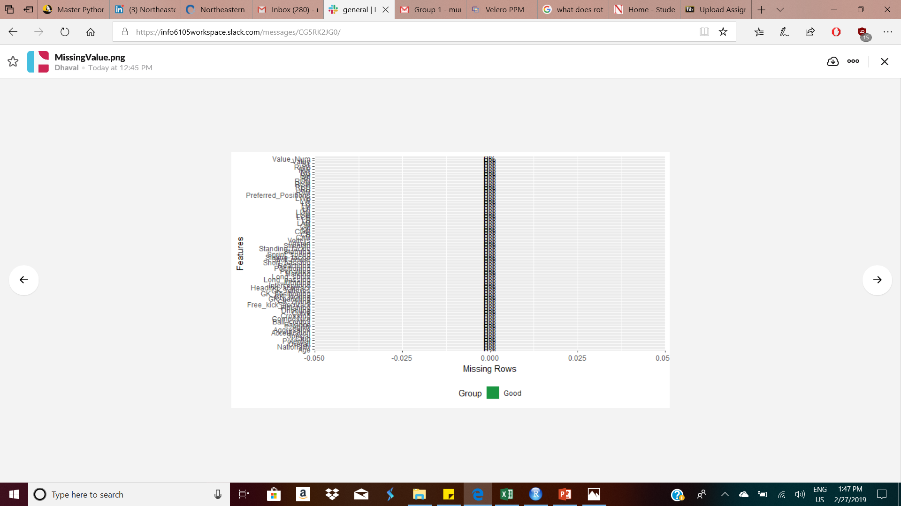
Missing Values :
Before Cleaning
After Cleaning

Slide 6
PCA Analysis
Since we were working on a very large dataset with almost 69 variables it was necessary to find the strongest features that were affecting the Value Column.
Having to many features results in noise and difficulties in the data so performing Principle component Analysis helps in Dimensionality reduction and provides better visualization, perspective and less complexity of the data set.
After performing the PCA Algorithm on the dataset we found 30 components resulted in variance close to ~ 98%.
Therefore, in this case, we selected number of components as 30 [PC1 to PC30] and proceeded to the modeling stage.
We added the training data set with the 30 PCA Components and for testing we will use this 30 Components as predictor variables.

Slide 7
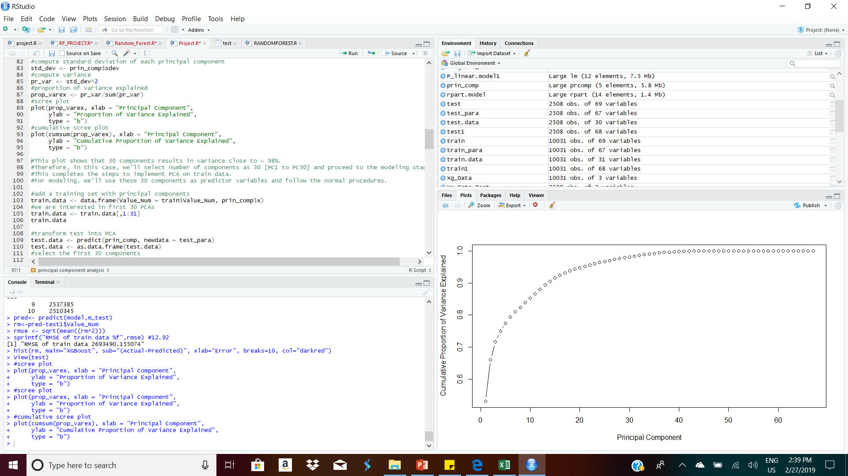
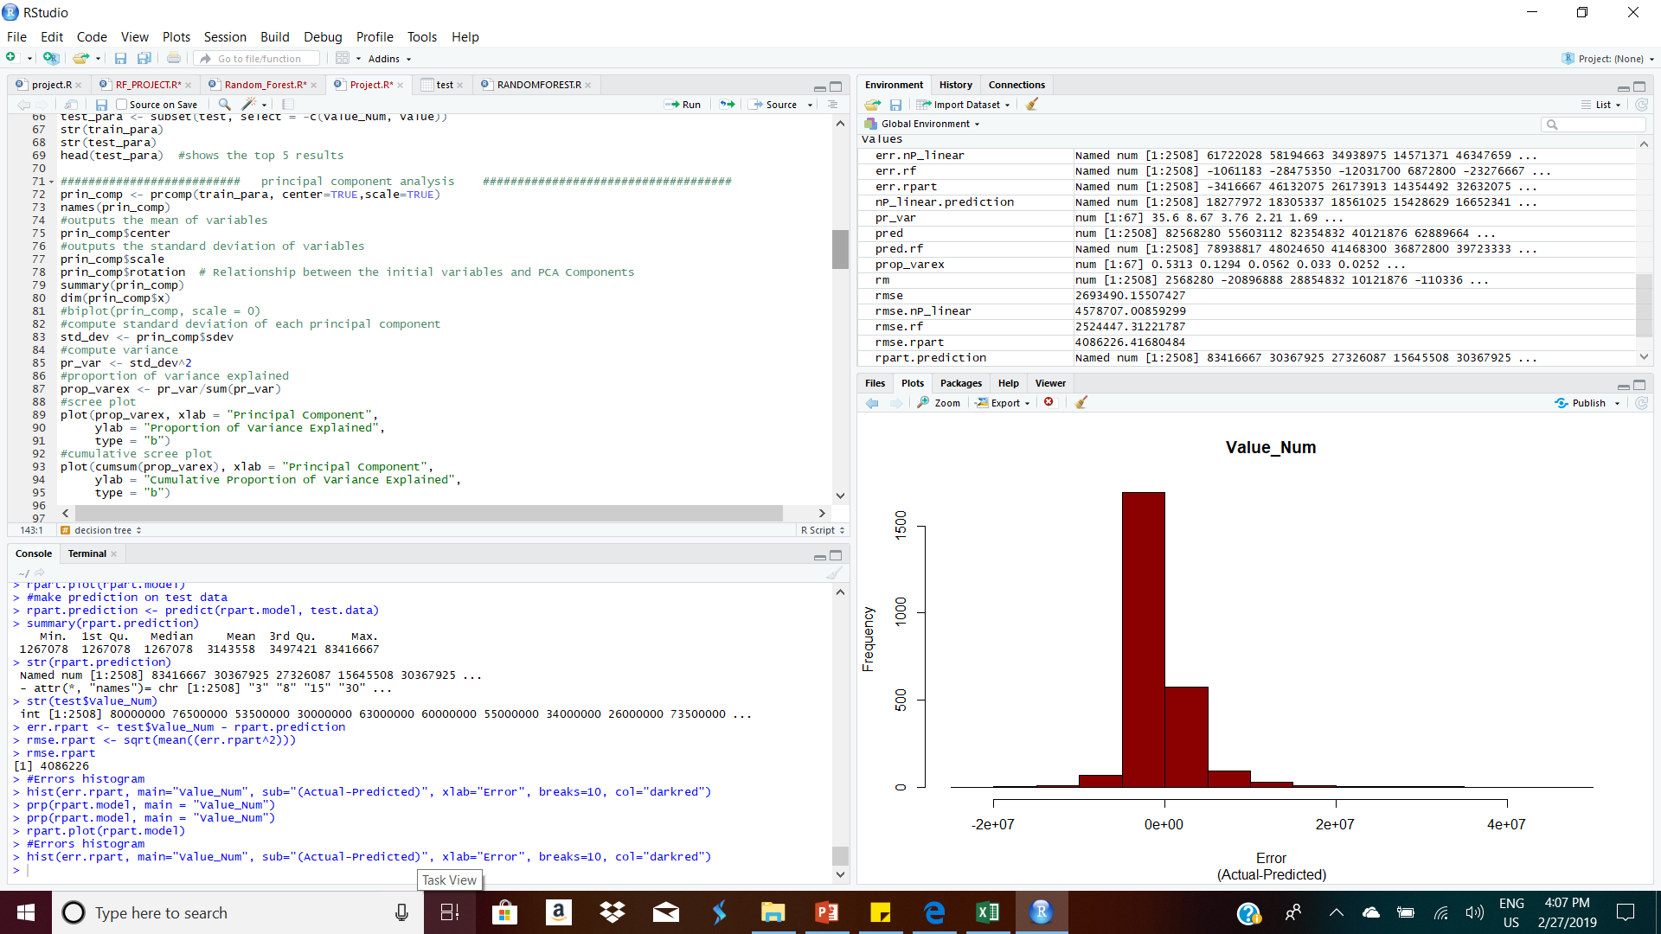
Plot for PCA

Slide 8
Linear Regression without PCA
In the case, we don’t use PCA dataset and just train the “lm” model by “original” (has been cleaned) dataset.
So, we can find some characteristics among all features.
The main step
All features is added to the train model as independent variables.
Select some important and meaningful features to create a new model.
Repeat step 2
Get the complete model which features are all significant (low p-value)

Slide 9
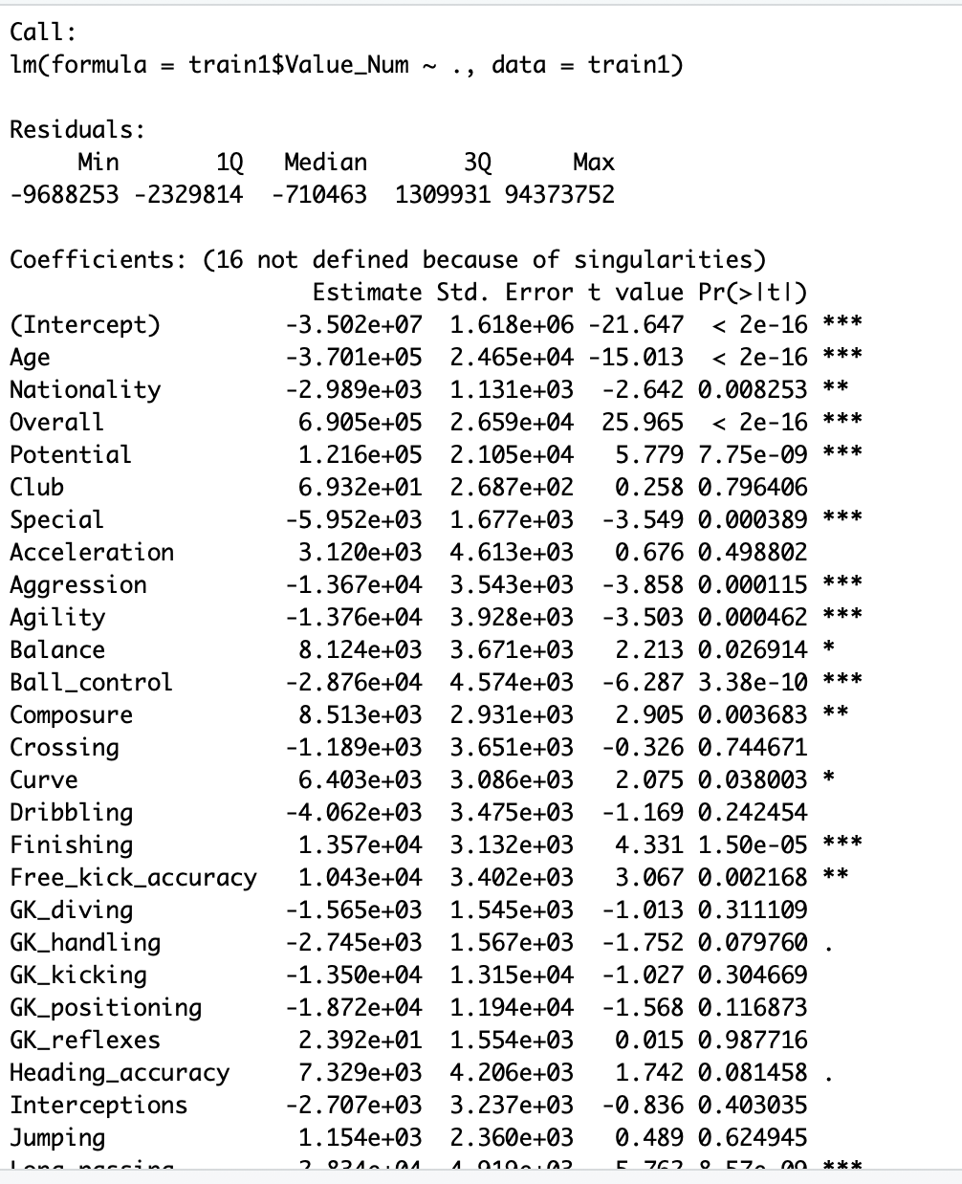
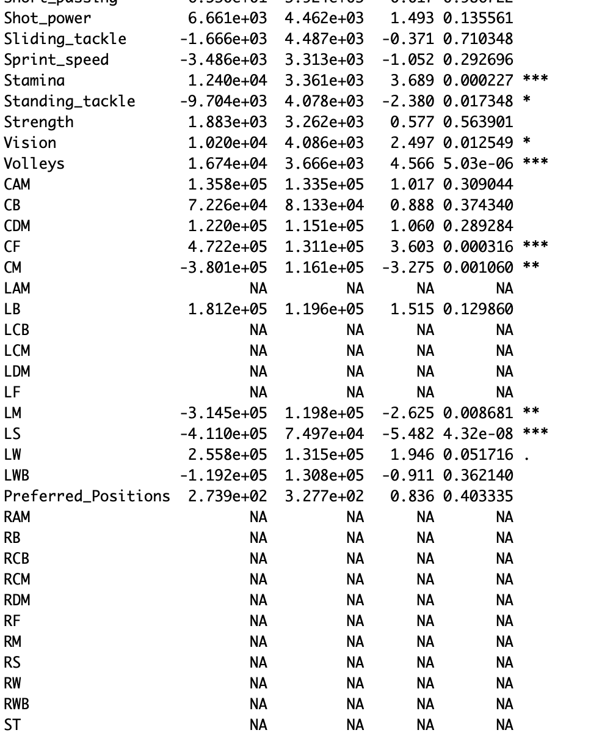
Step 1: all features
In the step, all features is added to the train model as independent variables.

Slide 10
Step 1: all features (cont.)
The result shows two problems
There are some features with high p-value
It means they are not important
There are some features without p-value (shown as NA)
It is because that they are highly correlated with other variables
So, we have to deal with it in next step

Slide 11
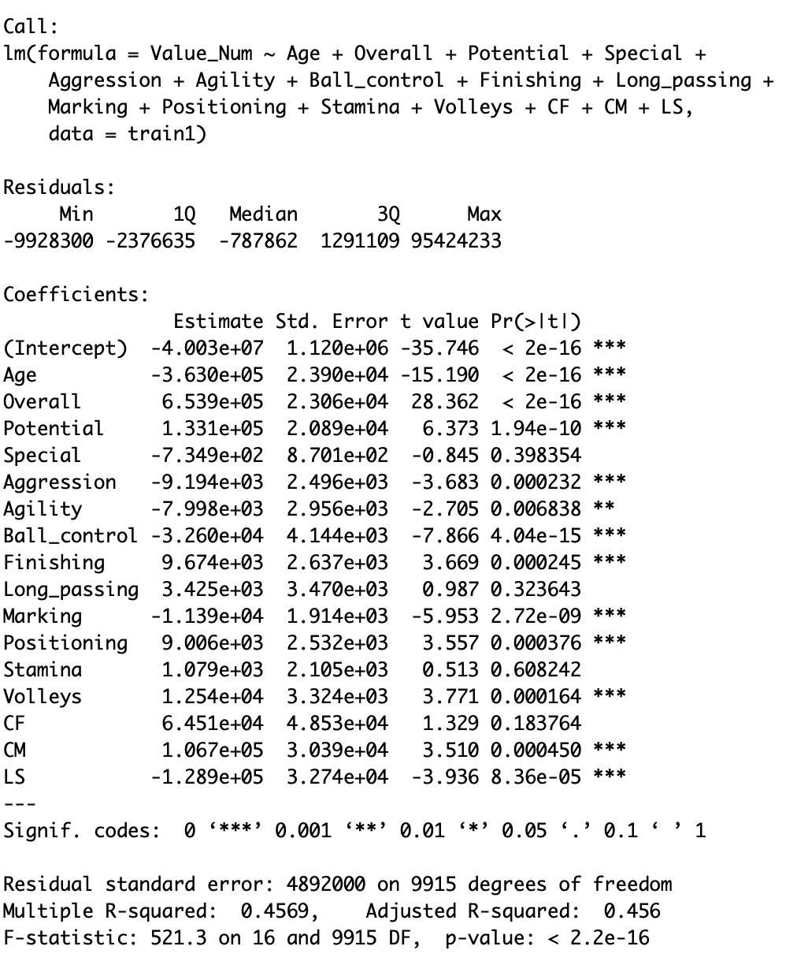
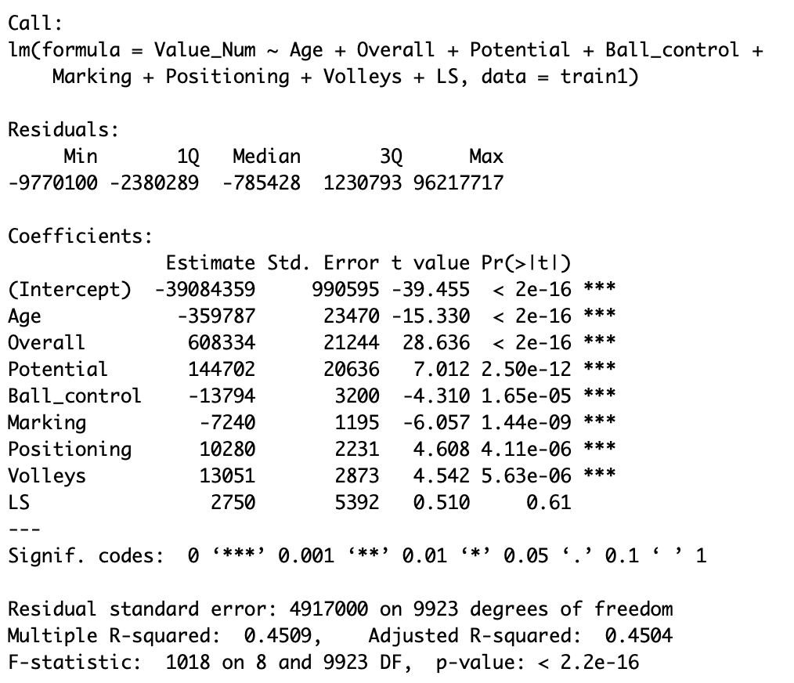
Step 2/3: Select significant features
We select the relatively important features from the model gotten in last step and create a new model.

Slide 12
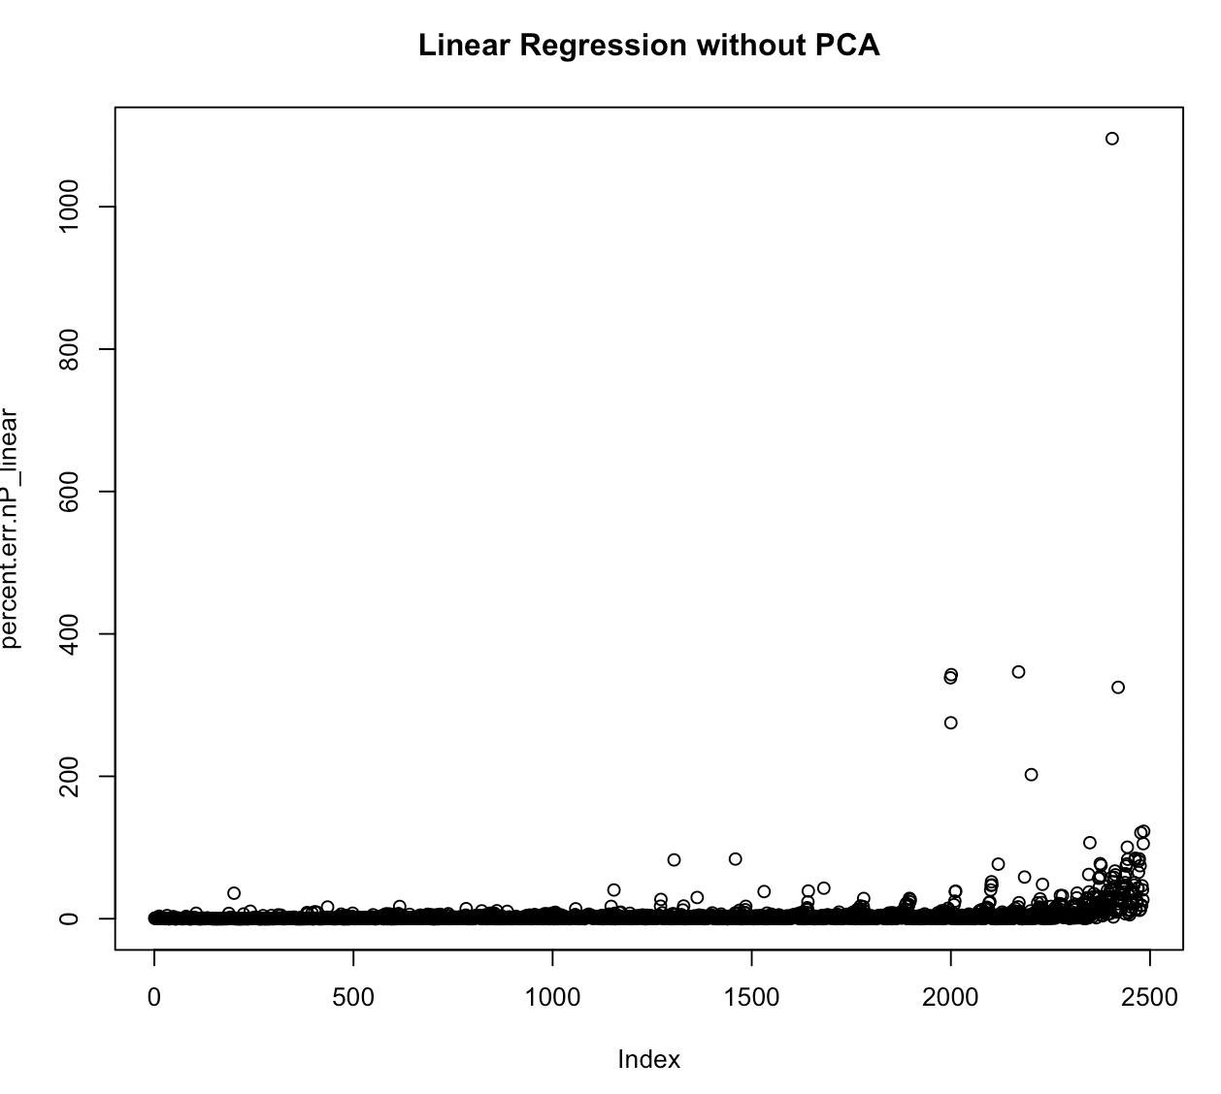
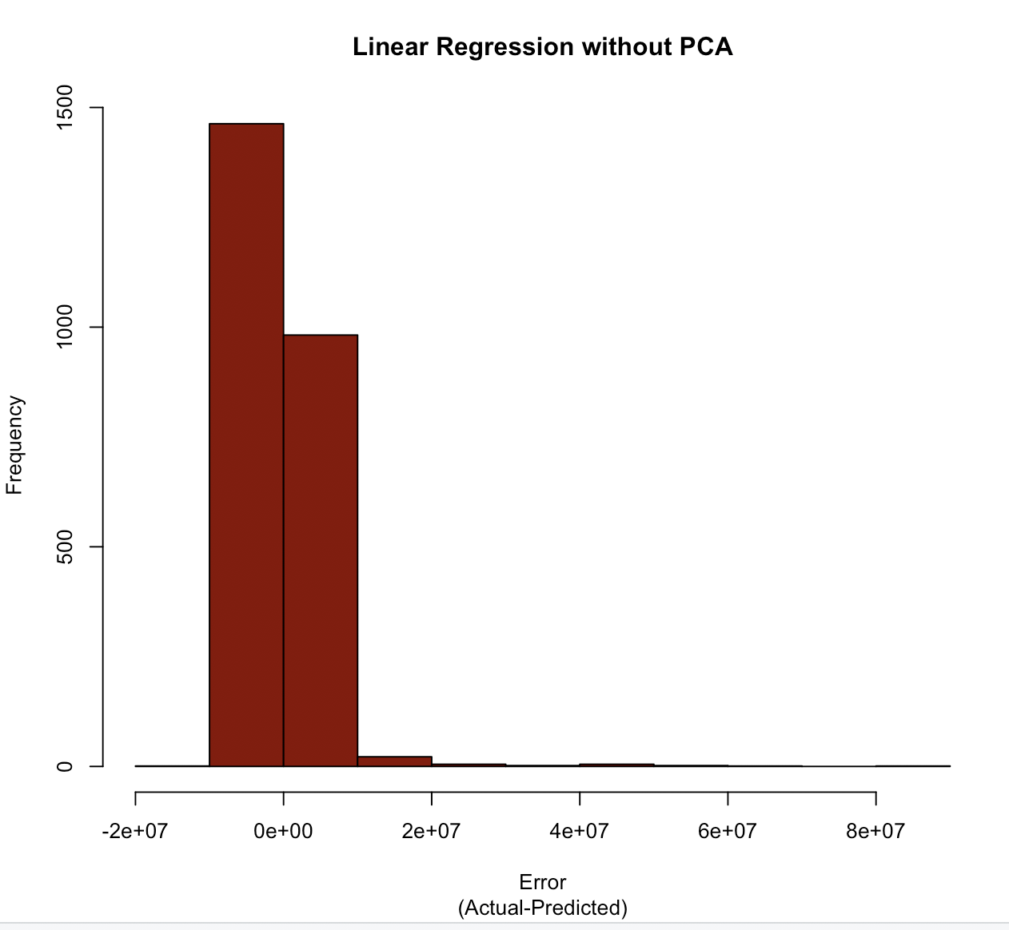
Step 4: get final model
Finally, there are 7 variables left and using them to train the model.
Make the prediction using the test dataset and the result.
Calculate the error between actual value and predicted value.

Slide 13
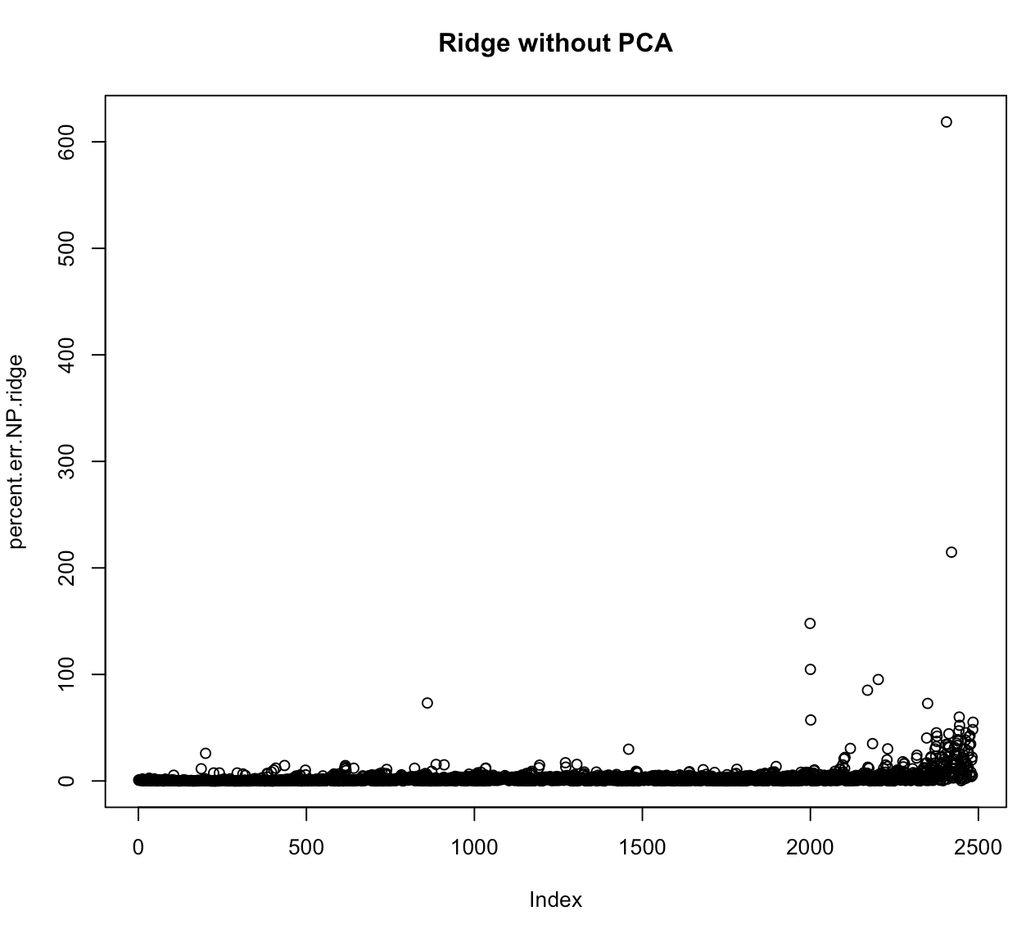
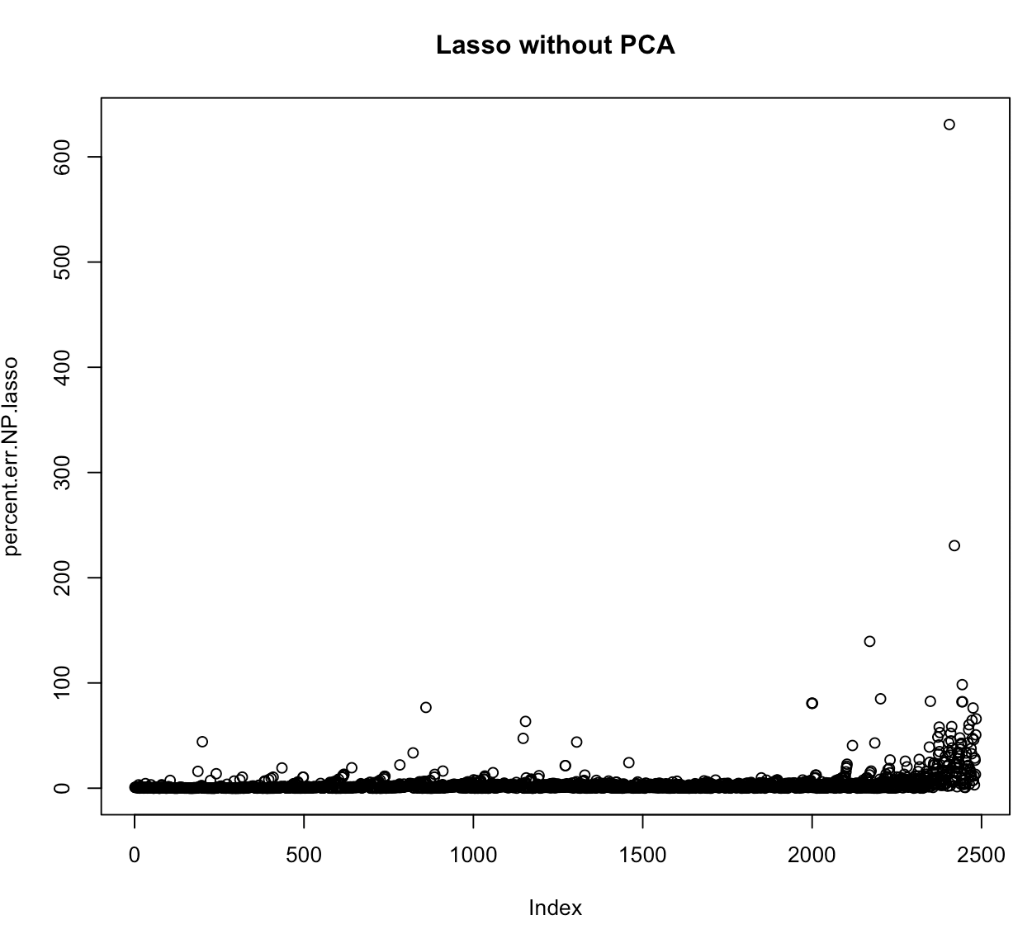
Lasso and Ridge
From the previous model, we find that although the error is small and the R-squared value is 0.4509.
Maybe the model is a little underfitting.
So we use lasso and Ridge to overcome underfitting.
The Ridge is a little better

Slide 14
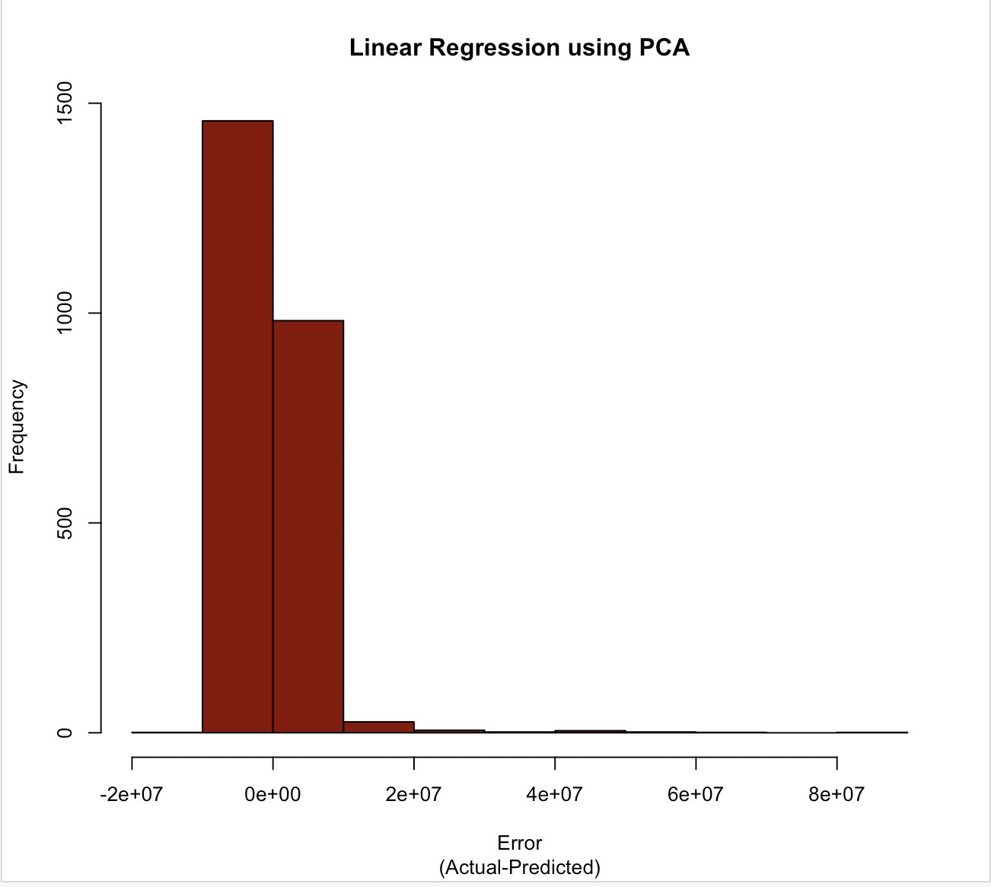
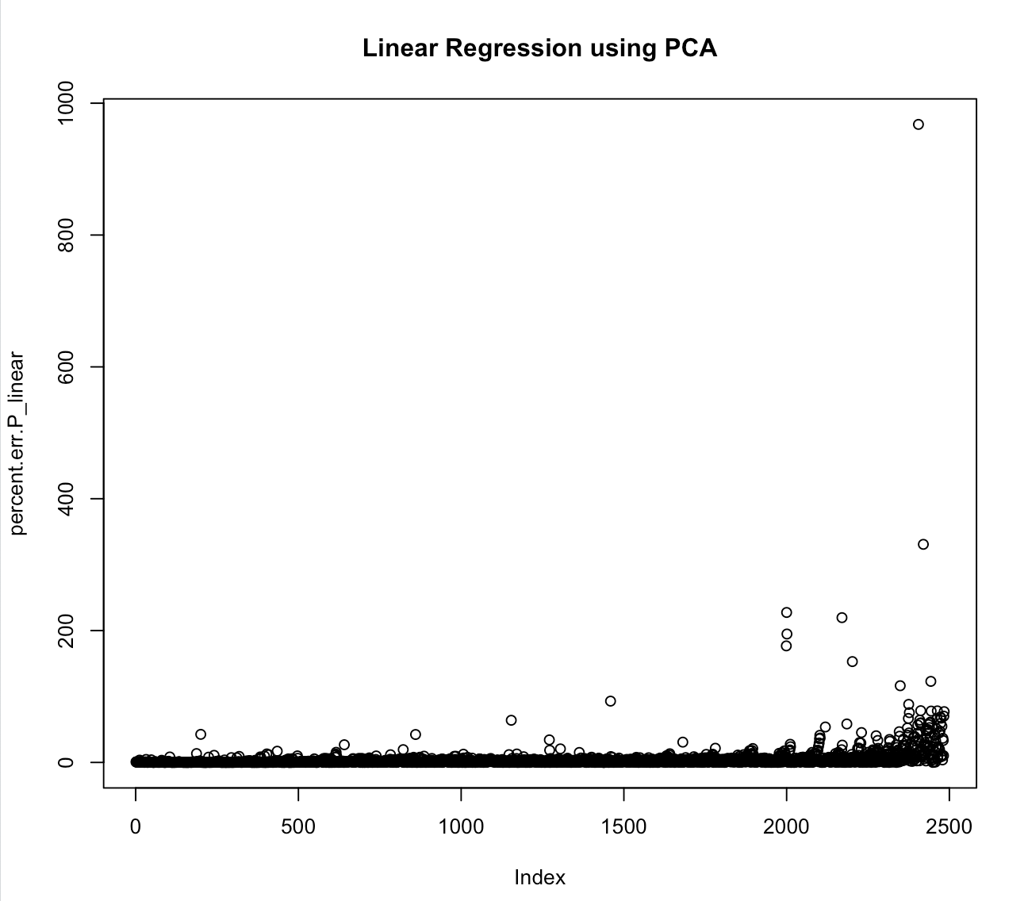
Linear Regression with PCA
We use the PCA train and test dataset to create a model and make a prediction test.

Slide 15
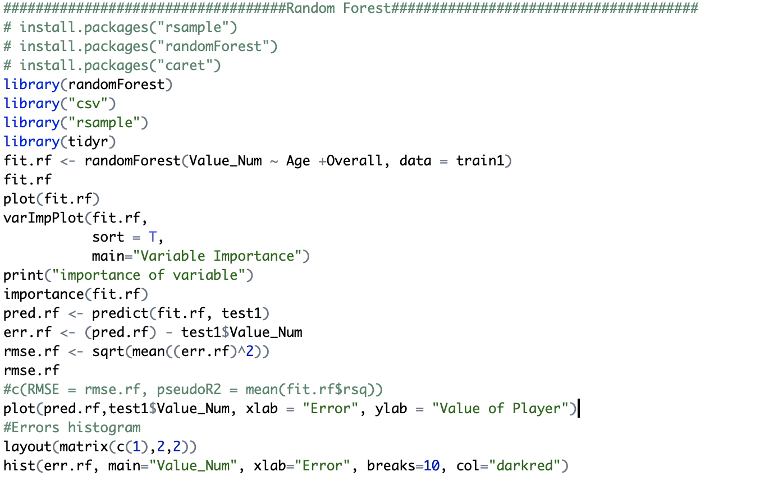
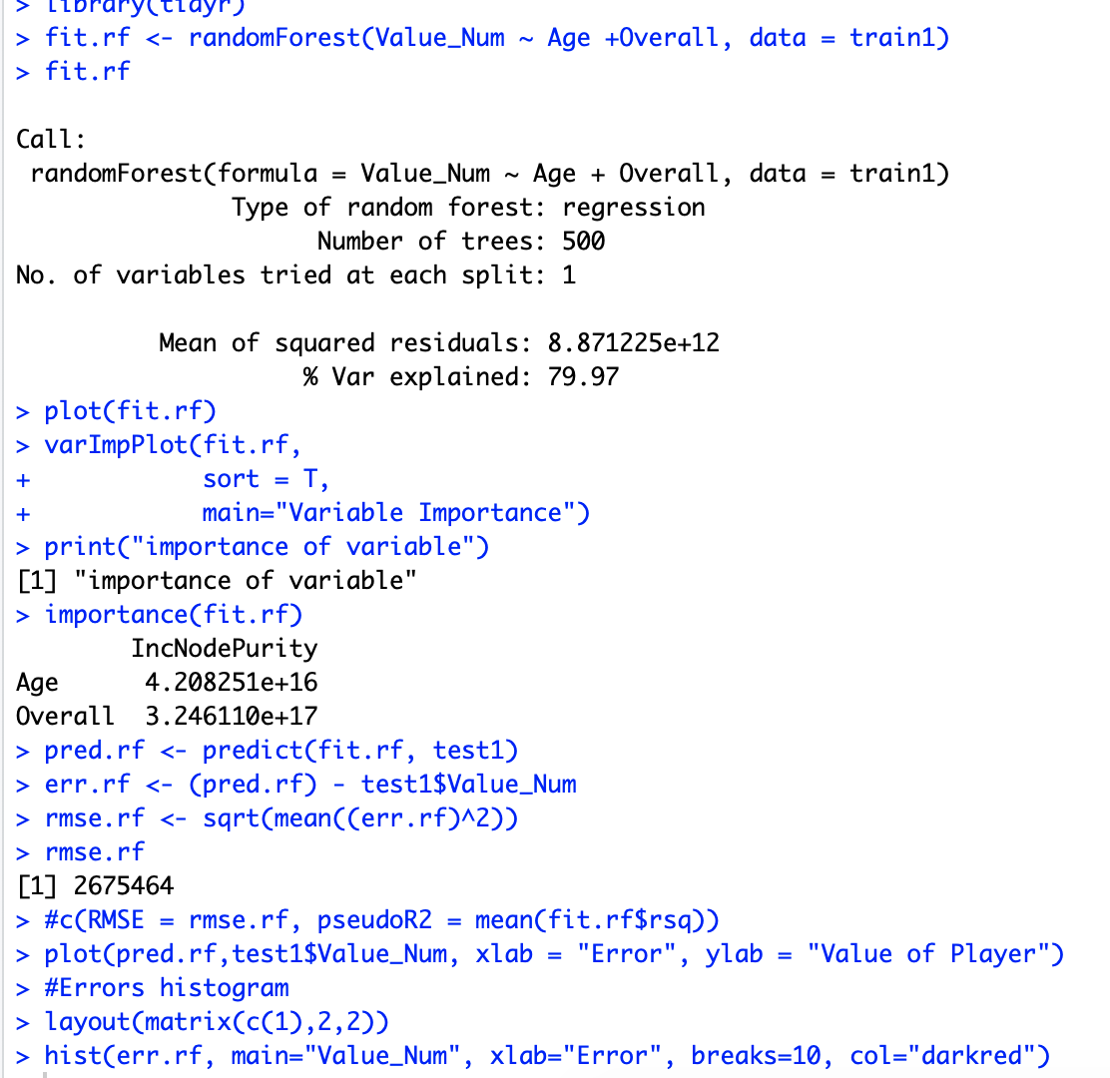
RANDOM FOREST ALGORITHM
Random Forest algorithm is a supervised algorithm. We can see it from its name, which is to create a forest by some way and make it random. There is a direct relationship between the number of trees in the forest and the results it can get.

Slide 16
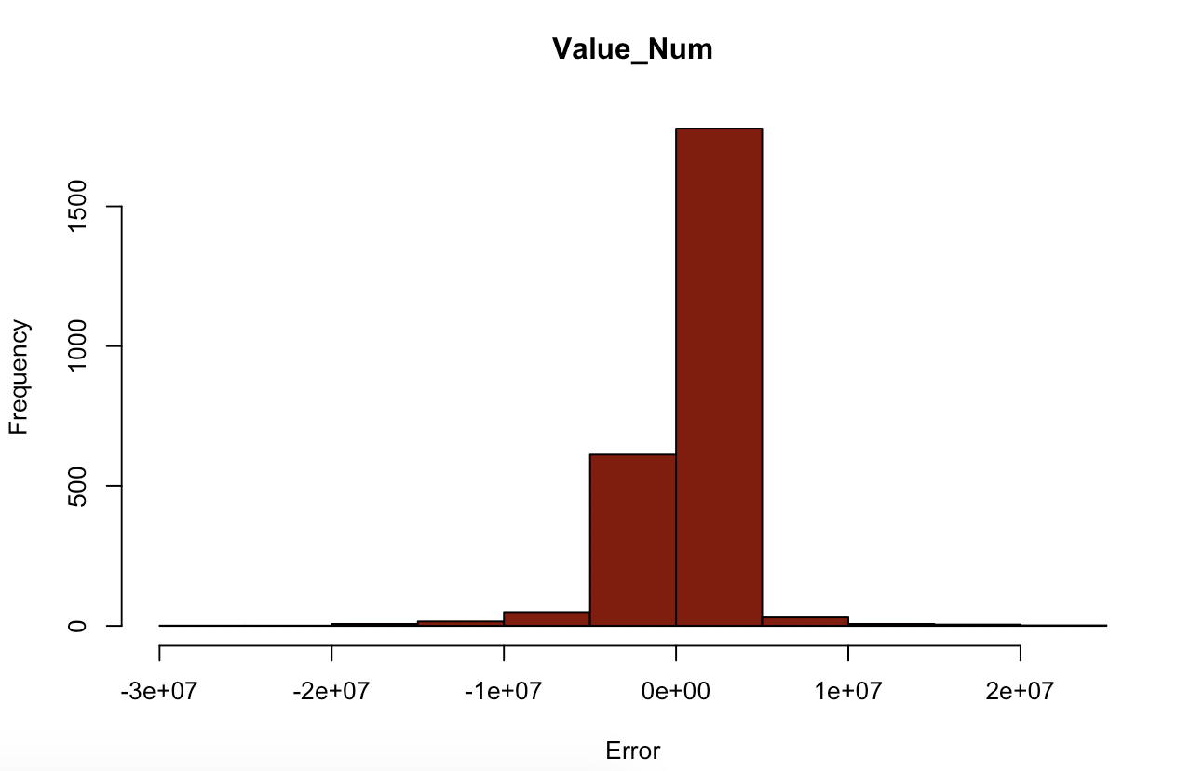
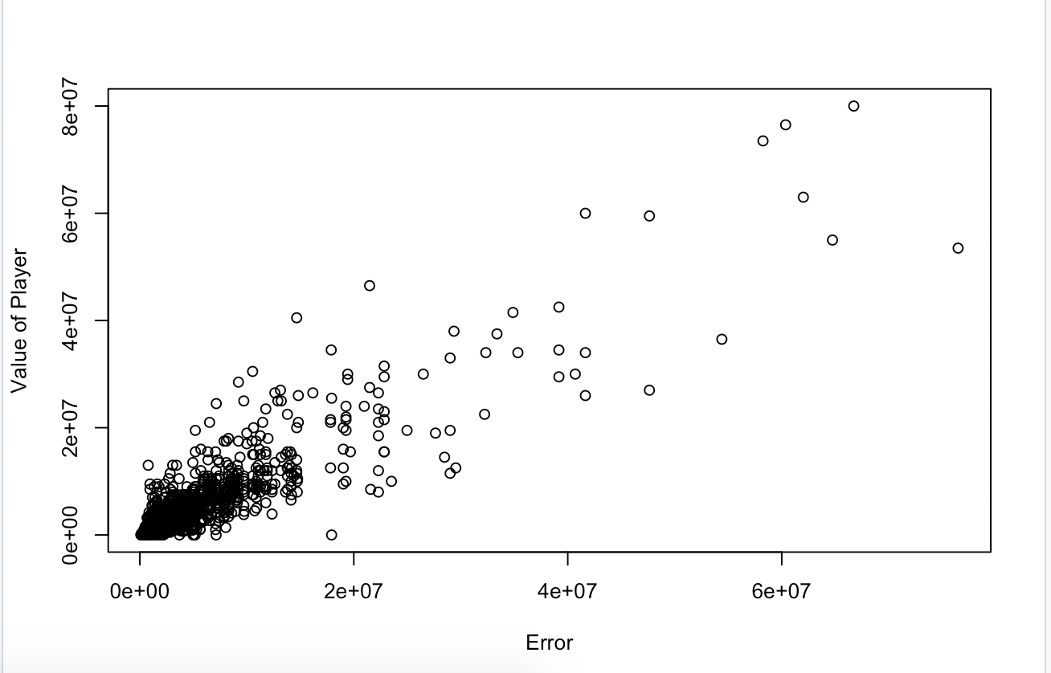
GRAPHS OF RANDOM FOREST

Slide 17
Decision Tree
Decision Tree is mainly used to perform classification and regression.
In this supervised learning model, we use a set of binary rules to calculate a target value.
We have used the rpart library which includes the function i.e the target variable and all the independent variable , the data on which we are performing classification or regression and the method that we are using either class- for classification or annova- for regression.
prp function i.e- plot the rpart is used to plot the decision tree.

Slide 18
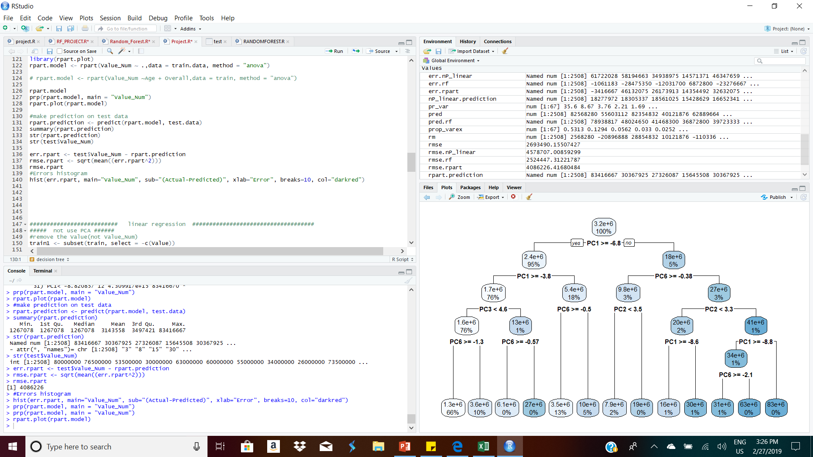
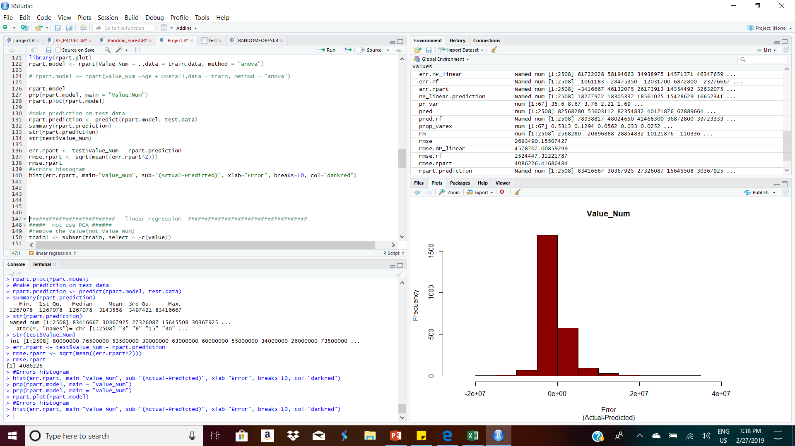
Decision tree- Output
We used all the 30 features that we got through PCA Analysis and we got this visualization for the decision tree.
The RMSE value that we got is-
rmse.rpart [1] 4086226
For visuation of the error we used histogram.

Slide 19

XGBoost
Xtreme Gradient Boosting is mainly used to implement machine learning algorithm and is used to improve the performance and to solve the problem in fast and accurate way.
We use the Xgboost library which contains boosting frame.

Slide 20
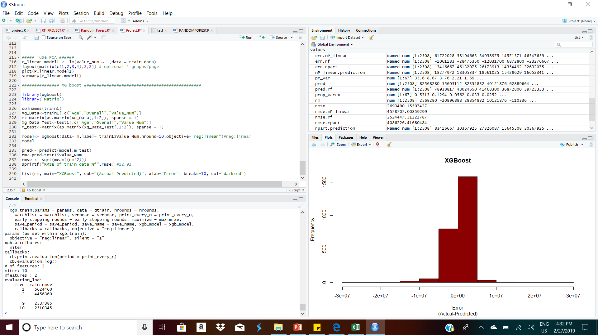
XGBoost Output:
The RMSE value after performing Xgboost is
"RMSE of train data 2693490.155074"

